Slide 1
Shell and Flashing Images
Commands and upgrades

Slide 2
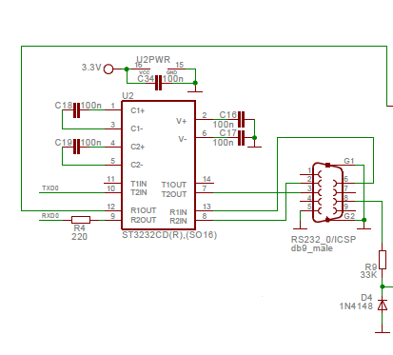
RS-232 Driver chip – ST3232C
Driver chip is ST3232C
Provides electrical interface between UART port and RS-232 hardware.

Slide 3
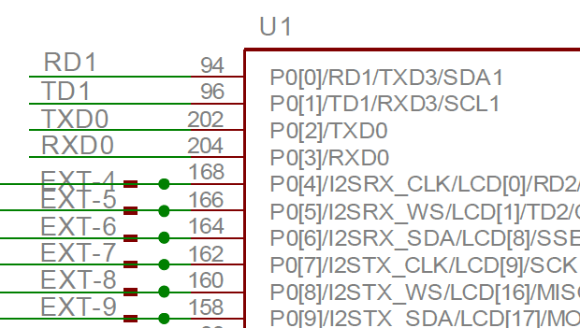
UART0 on LPC2478
Serial port is connected to P0_2 TXD0 and P0_3 RXD0 which is UART0

Slide 4
Initialize UART for interrupts
void UARTInitInterrupt(void(*handler)(void))
{
// Set as UART interrupt as IRQ and not FIQ
VICINTSELECT_bit.UART0 = 0;
// Set handler
VICVECTADDR6 = (unsigned int)handler;
// VICIntEnable
VICINTENABLE_bit.UART0 = 1;
U0IER_bit.RXLSIE = 1;
U0IER_bit.RDAIE = 1;
}

Slide 5
Shell Code
See TinyOS_Shell_LPC2478.zip

Slide 6
Flashing IMages

Slide 7
Upgrading devices in the field
Very common problem
Needs to be done carefully to prevent ‘bricking’ the device.
Need to be able to upgrade main software yet recover if there is an error.
Often done by splitting code on the device into parts
bootloader
main code
That way the main code can be upgraded without damaging a bootloader.
The bootloader can always boot the device even if the main area has been corrupted.

Slide 8
Bootloader
Starts initial boot then jumps to either
bootloader monitor – ie, shell
Main application
As part of its startup sequence there is a part where tests for some condition
If true it runs the shell monitor
If false it runs the main application
Condition might be
Keys held down
Repeating magic word on serial port
etc.

Slide 9
Bootloader Shell
A little command shell that receives commands through serial or other port.
Executes the commands
Prints results to the port.
Commands are a string starting with the command name then followed by parameters.
show status
run task
flashImage newbits.hex 0x40000000
Commands can be implemented by the bootloader task itself or by other tasks waiting for a signal or created on demand.

Slide 10
Bootloader Flash command
Can read new bits from a external memory such as an SD card or receive the bits from a port.
If from a SD card then it’s a matter of copying the bits from the card to right location in flash
If from a port then it will require a protocol between the bootloader and the client sending the bits.
Does not have to be very complicated but needs at least have start, repeat, reset, stop, and many run.
Data can be either binary or some easy to work with character based encoding. Should include checksum.
For example Motorola S-Records or Intel Hex
Bootloader needs to decode and convert to binary.

Slide 11
Flashing process
Desktop client sends line of data
Bootloader
Decodes data
Checks checksum
Writes data to memory
Sends acknowledge for new data or repeat on error
Repeat until done
Jump to main application

Slide 12
Requirements for flashing
Main application has to be built for a specific fixed memory location.
Binary is correct for final memory location.
Bootloader does not have to modify the binary.
Compiler and link settings for specifying load location
If using encoding then the main application binary is converted to the encoding format.
For example S-Record.
Text encoding can be easier to work with and less likely to be corrupted then binary.
Some tools will change binary
Serial port might only support 7-bits
Human readable
Does increase the size of the image.
Binary image will also work if tools do checksum on the fly.

Slide 13
S-Records
From Wikipedia
The Motorola S-record format is an ASCII hexadecimal ("hex") text encoding for binary data. It is also known as the SREC or S19 format.
Each record contains a checksum to detect data that has been corrupted during transmission.
The first record (S0) may include arbitrary comments such as a program name or version number. The last (termination) record (S7, S8, or S9) may include a starting address.
http://en.wikipedia.org/wiki/SREC_(file_format)

Slide 14
S-Record Format

Slide 15
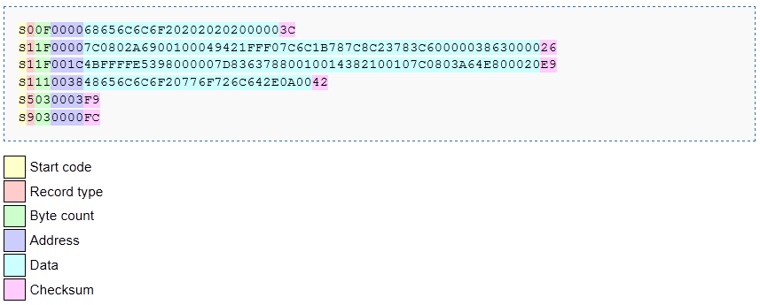
S-Record parts

Slide 16
S-Record Example
S00600004844521B
S30D8000000041FFFFF080000400BF
S3258000040041F9800000004E7B8801720041F940000BD4243C40000D78048240000BD4670648
S3258000042010C1538266FA4FF941FFFFF041EFFFFC23C840000BD44EB98000105641F800005E
S325800004404E7B88012E502F2800044E750000436F70797269676874202843292032303130D8
S32580000520E4881001E4884E754281202F0004E58812004200E588100132004240E5883001E2
S325800005404E754281202F0004E288EB883200E2883001EA884E7542804281302F0006EB8800
S3258000056032004240E889E68880814E754280302F0006243C000007E02200C082E388ED89EB
S31940000BC00080010001000100010000805555400005D24E7157
S7058000040076
The S0 record starts the file.
The S3 records contain the data.
The S7 record contains the entry address and terminates the download.

Slide 17
S-Record Tools
GNU binutils can generate S-Record files
objcopy can be used to generate S-records by using an output target of srec
objcopy Myapp.bin -O srec
Many others available on internet
http://sourceforge.net/projects/srecord/
http://www.s-record.com/

